Slide 1
Minimum Spanning Tree (Kruskal’s Algorithm)
Md Mehrab Hossain Opi

Slide 2
Introduction
We already discussed about Minimum Spanning Tree.
We studied Prim’s algorithm earlier.
Today we will focus on Kruskal’s Algorithm.

Slide 3
Introduction
We will use the concept of Disjoint Set Union.
Initially put each vertex in its own set.
We will keep merging sets until there remains only one.

Slide 4
Implementation
Initialization
Sort all the edges according to weight.
Put each vertex in its own tree.
Call make_set for each vertex.

Slide 5
Implementation
Iterate through all the edges
Find whether the end nodes belong to same tree.
Call find_set for end nodes.
If the nodes belong to different trees then merge them.
Call union_sets(u,v).

Slide 6
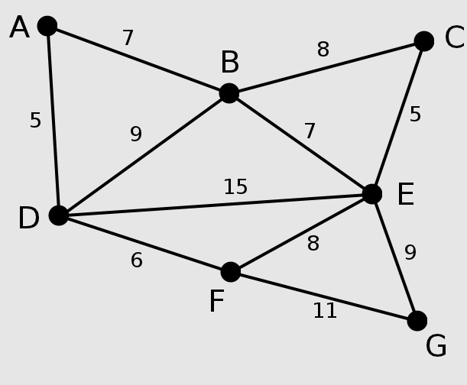
Example

Slide 7
Example
Initialize the Minimum Spanning Tree.
A | B | C | D | E | F | G
A | B | C | D | E | F | G

Slide 8
Example
Iterate through the edges in sorted order.
A | B | C | D | E | F | G
A | B | C | D | E | F | G

Slide 9
Example
Smallest edge now is (A,D) with cost 5.
A | B | C | D | E | F | G
A | B | C | D | E | F | G

Slide 10
Example
They belong to different tree.
A | B | C | D | E | F | G
A | B | C | D | E | F | G

Slide 11
Example
So we merge the two nodes.
A | B | C | D | E | F | G
A | B | C | A | E | F | G

Slide 12
Example
Smallest edge now is (C,E) with cost 5.
A | B | C | D | E | F | G
A | B | C | A | E | F | G

Slide 13
Example
They belong to different tree.
A | B | C | D | E | F | G
A | B | C | A | E | F | G

Slide 14
Example
So we merge C and E.
A | B | C | D | E | F | G
A | B | C | A | C | F | G

Slide 15
Example
Current minimum edge is (D,F) with cost 6.
They belongs to different tree.
A | B | C | D | E | F | G
A | B | C | A | C | F | G

Slide 16
Example
We can merge D and F.
A | B | C | D | E | F | G
A | B | C | A | C | D | G

Slide 17
Example
Next we can merge A and B.
A | B | C | D | E | F | G
A | A | C | A | C | D | G

Slide 18
Example
How will the array change now?
Then we can merge B and E.
A | B | C | D | E | F | G
A | A | C | A | C | D | G
A | B | C | D | E | F | G
A | A | C | A | B | D | G
Is it correct?
No

Slide 19
Example
How will the array change now?
Then we can merge B and E.
A | B | C | D | E | F | G
A | A | C | A | C | D | G
A | B | C | D | E | F | G
A | A | A | A | C | D | G

Slide 20
Example
Next we have (B,C) with cost 8.
A | B | C | D | E | F | G
A | A | A | A | C | D | G
They have same parent.
So we can’t take this edge.

Slide 21
Example
Next we have (E,F) with cost 8.
A | B | C | D | E | F | G
A | A | A | A | C | D | G
Do they have same parent?
Yes. So no need to merge.
The table will be updated.
A | B | C | D | E | F | G
A | A | A | A | A | A | G

Slide 22
Example
Finally we can merge E and G.
A | B | C | D | E | F | G
A | A | A | A | A | A | A
Now we have only one set(tree).

Slide 23
Complexity
Sorting the edges will take O(E log E).
Initializing tree will take O(V).
Merging the trees will take O(E).
Final complexity = O(E log E)+ O(V) + O(E) = O(E log E).

